Slide 1
Solar Cell Characterization
By Adeline Antolis and Malith Rajapakse 23rd May 2018
Notes:
Add in dates. Keep clean and neat.

Slide 2
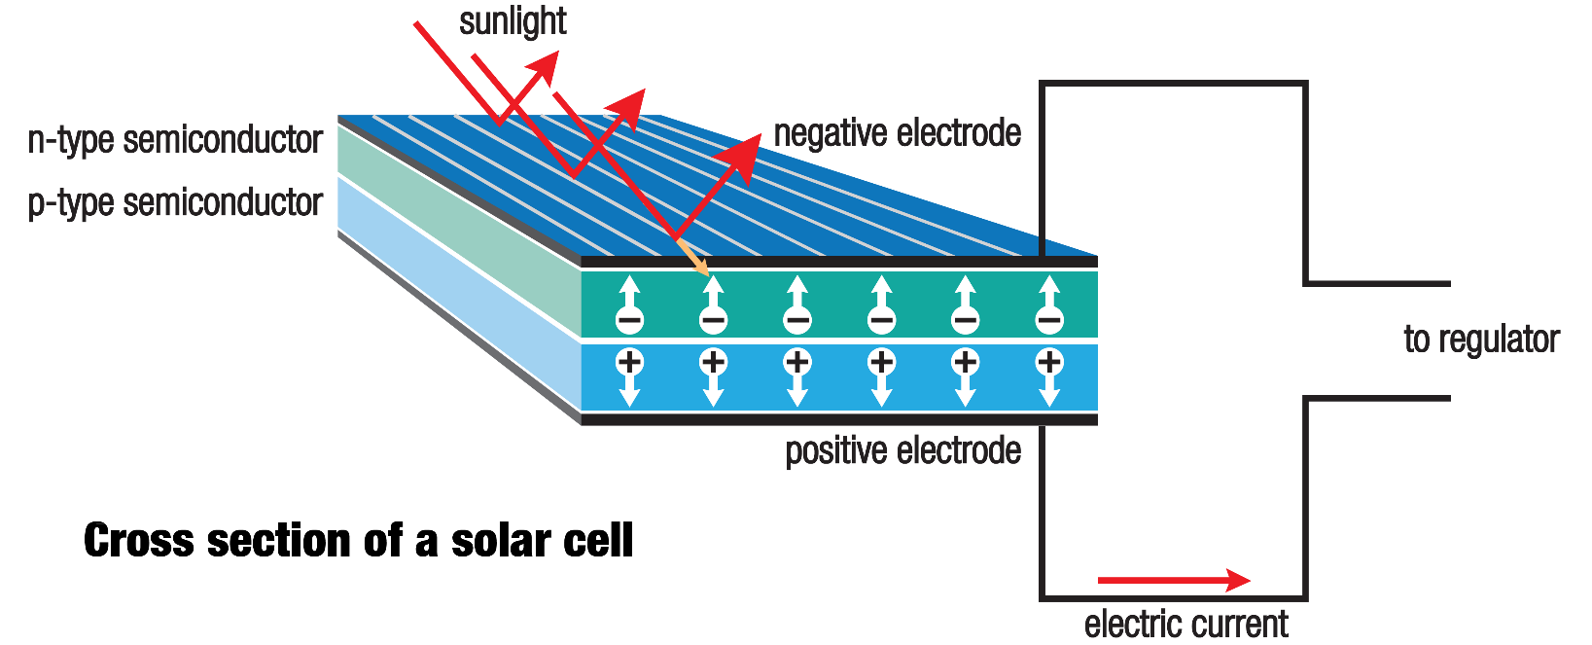
What is a solar cell?
Device that converts energy of light into electricity

Slide 3
What is solar cell characterisation?
Quantitave tool to measure the performance of a solar cell
Provides vital information on different factors affecting the performance
Used to compare different solar cells
Gives researchers ideas on how to improve a solar cell
Notes:
Motivation for the research. We have 40 research doing research for solar cell research and printable. 100 solar cells in 1 hr.

Slide 4
Why are we studying solar cell characterisation?
Research on printable, perovskite-based solar cells → many new solar cells created
Set up constructed for characterising up to 100 solar cells/hr
Reliable method for characterisation

Slide 5
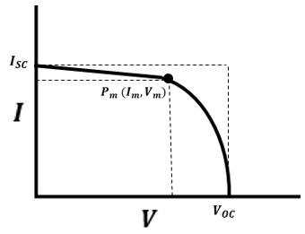

How are solar cells characterized?
Apply voltage across solar cell and measure current whilst stepping voltage
Model IV (current-voltage) curve and extract parameters from mathematical model
Important points:
Short circuit current $I_{SC}$
Open circuit voltage $V_{OC}$
Maximum power point $P_{M}$
Notes:
Introduce a solar cell. (30 seconds). You apply voltage across not against and you step the voltage and measure the current at each point.

Slide 6
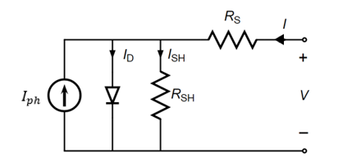
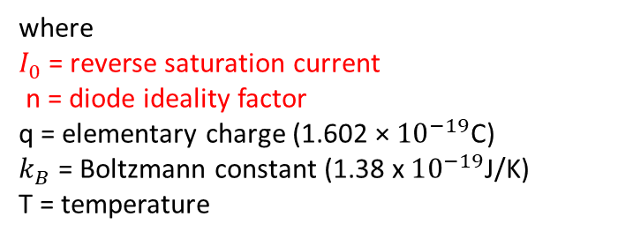


Single Diode Model
Model of equivalent electrical circuit
No light → Diode
${ I}_{D}$ = diode current
= $I_{0}\left(e^{\frac{q\left(V−R_{s}I\right)}{nk_{B}T}}−1\right)$
where $I_{0}$ = reverse saturation current n = diode ideality factor q = elementary charge (1.602 × ${10}^{−19}$C) $k_{B}$ = Boltzmann constant (1.38 x $10^{−19}$J/K) T = temperature
Notes:
Circle and explain. Take about recombination. High the voltage the more charge is recombined.

Slide 7

Single Diode Model
Model of equivalent electrical circuit
Current source in parallel with a diode
${ I}_{ph}$ = photocurrent
Notes:
Circle and explain. Take about recombination. High the voltage the more charge is recombined.

Slide 8

Single Diode Model
Model of equivalent electrical circuit
Non-idealities
${ R}_{s}$ = series resistance
${ R}_{sh}$ = shunt resistance
Ideal solar cell has low ${ R}_{s}$ and high $R_{sh}$
Notes:
Circle and explain. Take about recombination. High the voltage the more charge is recombined.

Slide 9

Single Diode Model
Model of equivalent electrical circuit
Characteristic Equation
$$I=I_{0}\left(e^{\frac{q\left(V−R_{s}I\right)}{nk_{B}T}}−1\right)+\frac{V−R_{s}I}{R_{sh}}−I_{ph}$$
5 parameters - $I_{0}$, $R_{s}$, ${n\text{, }R_{sh}\text{, }I}_{ph}$
Implicit – difficult to extract parameters

Slide 10
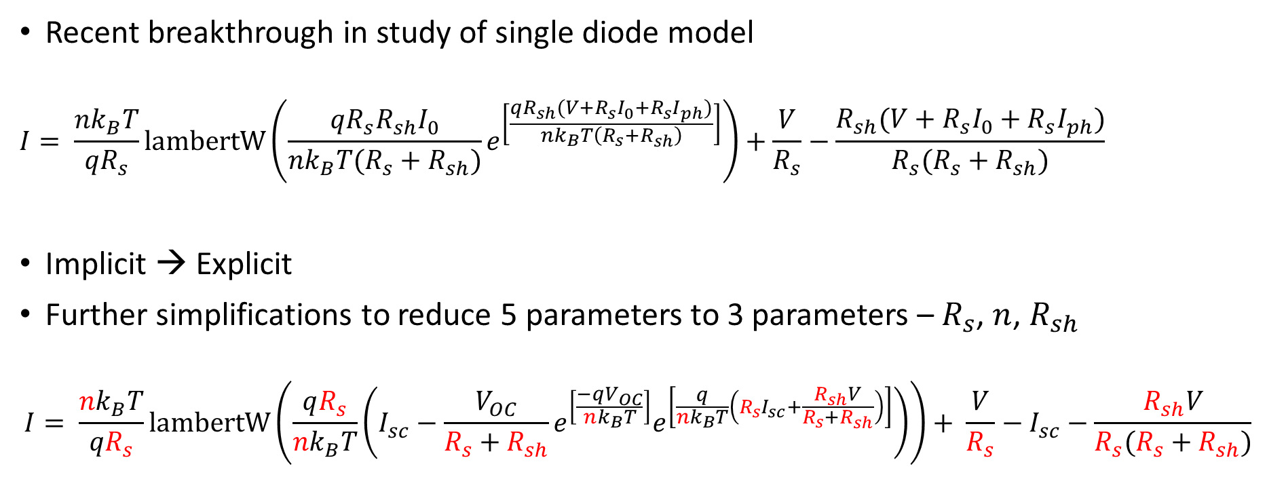
Lambert W Function
Recent breakthrough in study of single diode model
$$I= \frac{nk_{B}T}{{qR}_{s}}lambertW\left(\frac{qR_{s}R_{sh}I_{0}}{nk_{B}T(R_{s}+R_{sh})}e^{\left[\frac{qR_{sh}(V+R_{s}I_{0}+R_{s}I_{ph})}{nk_{B}T\left(R_{s}+R_{sh}\right)}\right]}\right)+\frac{V}{R_{s}}−\frac{R_{sh}(V+R_{s}I_{0}+R_{s}I_{ph})}{R_{s}(R_{s}+R_{sh})}$$
Implicit → Explicit
Further simplifications to reduce 5 parameters to 3 parameters – $R_{s}$, $n$, $R_{sh}$
$$I= \frac{nk_{B}T}{{qR}_{s}}lambertW\left(\frac{qR_{s}}{nk_{B}T}\left({I_{sc}−\frac{V_{OC}}{R_{s}+R_{sh}}e}^{\left[\frac{−qV_{OC}}{nk_{B}T}\right]}e^{\left[\frac{q}{nk_{B}T}\left(R_{s}I_{sc}+\frac{R_{sh}V}{R_{s}+R_{sh}}\right)\right]}\right)\right)+ \frac{V}{R_{s}}−I_{sc}−\frac{R_{sh}V}{R_{s}(R_{s}+R_{sh})}$$
Notes:
No Italics of lambert W

Slide 11
Problem Statement
Accuracy of parameter extraction depends on initial guesses
Bad initial guesses → unrealistic parameters
Notes:
Put the problem statement as early as possible. Have a aim slide, what is the aim and keep the

Slide 12
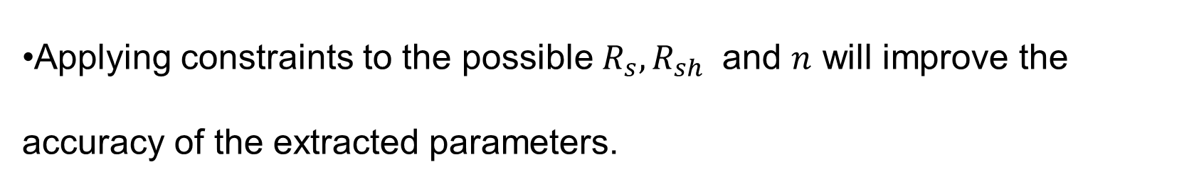
Hypothesis
Applying constraints to the possible $R_{s},R_{sh}$ and $n$ will improve the accuracy of the extracted parameters.
Objectives
Apply constraints to the parameters to improve accuracy of parameter extraction
Investigate for wide range of solar cells
Notes:
The future work cannot be the same as hypothesis.

Slide 13
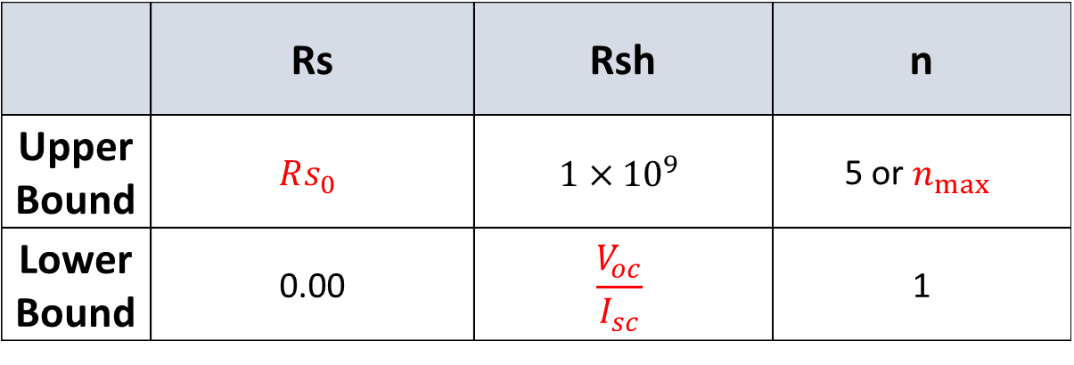
Parameter Constraints
 | Rs | Rsh | n
Upper Bound | $$Rs_{0}$$ | $$1×{10}^{9}$$ | 5 or $n_{max}⁡$
Lower Bound | 0.00 | $$\frac{V_{oc}}{I_{sc}}$$ | 1
Reduce the residual error between the experimental data and model

Slide 14
Methodology
Compare %error of extracted parameter from simulated parameters.
Compare root mean squares error (RMSE) for a literature solar cell IV curve.
Compare RMSE for a perovskite solar cell IV curve.

Slide 15
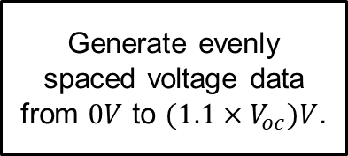
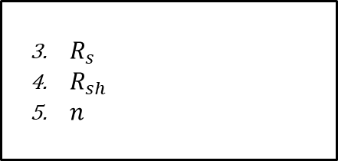
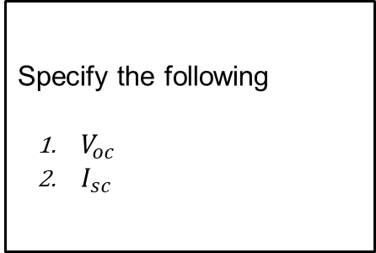
Simulate IV data
Specify the following
$V_{oc}$
$I_{sc}$
Introduce noise with signal to noise ratio (SR) of 45
Generate evenly spaced voltage data from $0V$ to $(1.1×V_{oc})V$.
Generate current with explicit single diode equation.
$R_{s}$
$R_{sh}$
$n$
Notes:
Remove the asterisk and put in multiplication symbol.
You need to explain why you are simulating data

Slide 16
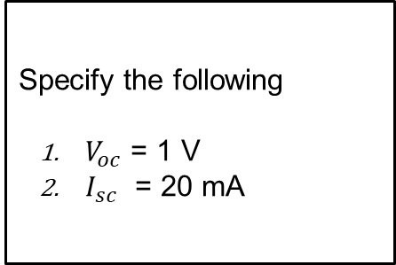
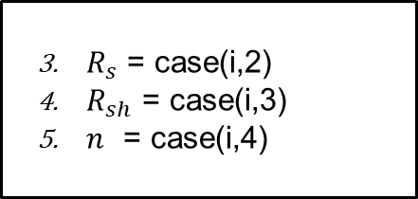
Simulated cases
Case | Rs (Ω) | Rsh (kΩ) | n
1 | 0.10 | 1.00E+03 | 1.00
2 | 25.00 | 1.00E+03 | 1.00
3 | 0.10 | 0.20 | 1.00
4 | 0.10 | 1.00E+03 | 2.50
5 | 25.00 | 1.00E+03 | 2.50
6 | 0.10 | 0.20 | 2.50
7 | 0.10 | 1.00E+03 | 5.00
8 | 25.00 | 0.20 | 5.00
Specify the following
$V_{oc}$ = 1 V
$I_{sc}$ = 20 mA
$R_{s}$ = case(i,2)
$R_{sh}$ = case(i,3)
$n$ = case(i,4)
Notes:
No need to explain.
Put in 1000’s instead of E
Reduce the number of cases.
Put ohms all the time

Slide 17
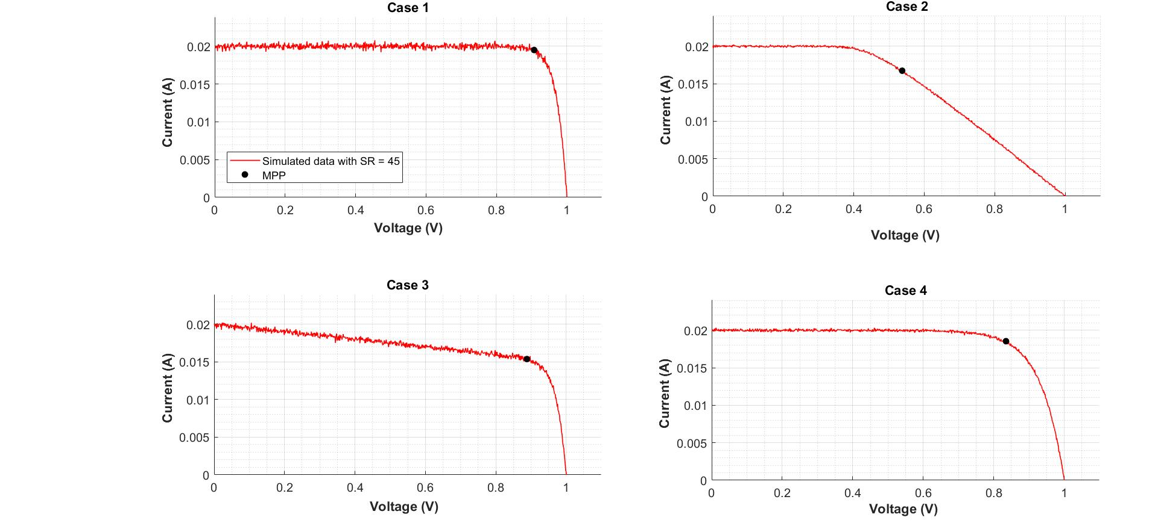
Simulated cases 1 - 4
Case | Rs (Ω) | Rsh (kΩ) | n
1 | 0.10 | 1.00E+03 | 1.00
2 | 25.00 | 1.00E+03 | 1.00
3 | 0.10 | 0.20 | 1.00
4 | 0.10 | 1.00E+03 | 2.50
Notes:
Case 1
Case 2
Case 3
Case 8

Slide 18
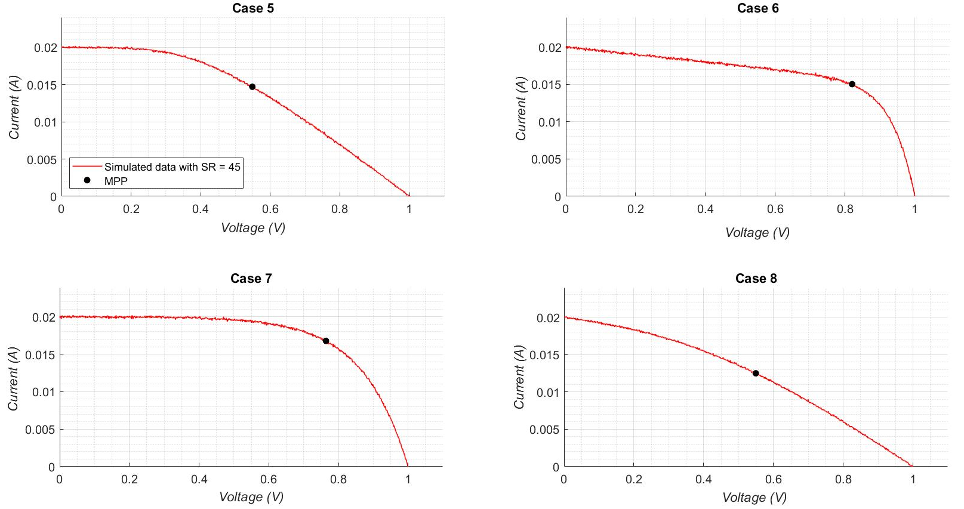
Simulated cases 5 - 8
Case | Rs (Ω) | Rsh (kΩ) | n
5 | 25.00 | 1.00E+03 | 2.50
6 | 0.10 | 0.20 | 2.50
7 | 0.10 | 1.00E+03 | 5.00
8 | 25.00 | 0.20 | 5.00

Slide 19
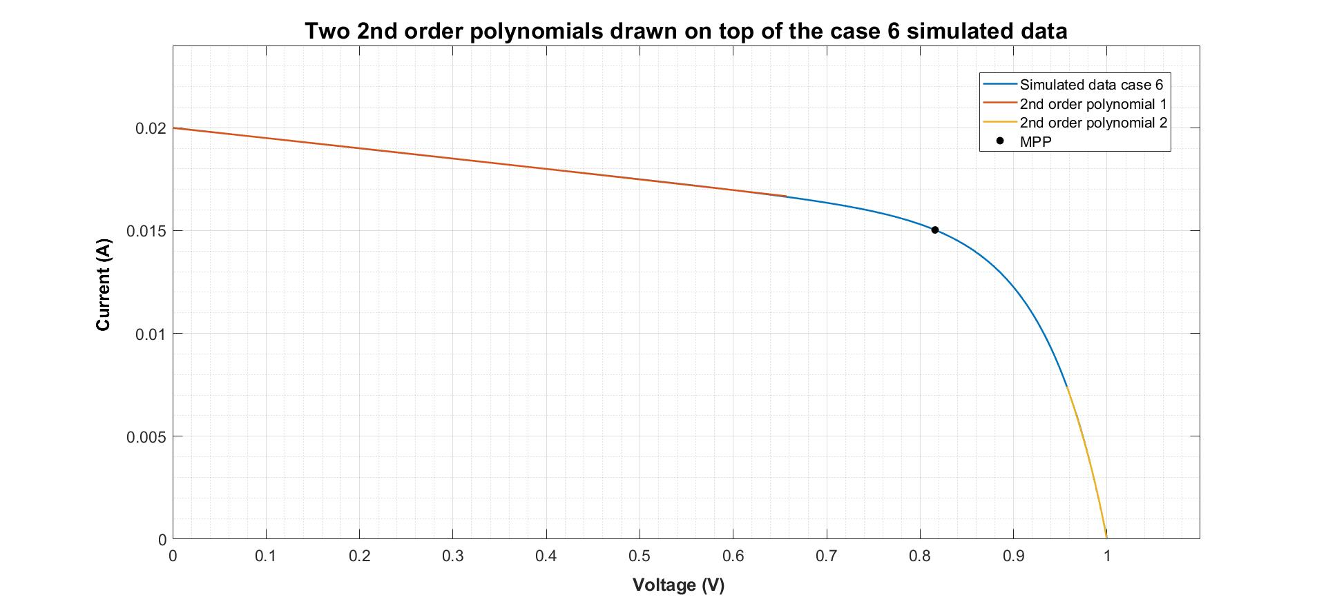


Parameter extraction: Gradients at $V = 0$and $V = V_{oc}$
Notes:
Remove everything on the slide.
To get the initial guess we need to get the gradients.
Colour code the gradients.

Slide 20
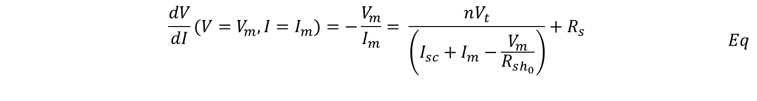
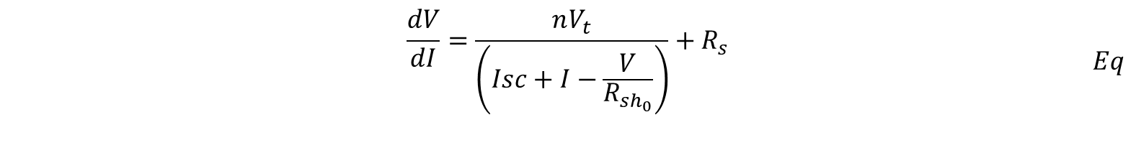
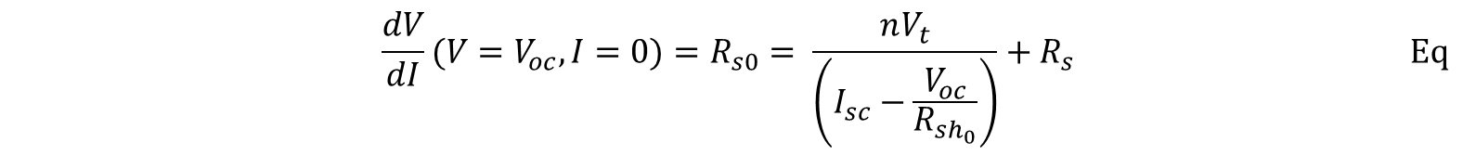
Parameter extraction (2) : Initial guesses
$$\begin{aligned}\begin{aligned}&\frac{dV}{dI}=\frac{nV_{t}}{\left(Isc+I−\frac{V}{R_{sh_{0}}}\right)}+R_{s}\#\#\end{aligned}\#Eq\end{aligned}$$
$$\begin{aligned}\begin{aligned}&\frac{dV}{dI}(V=V_{m}, I=I_{m})=−\frac{V_{m}}{I_{m}}= \frac{nV_{t}}{\left(I_{sc}+I_{m}−\frac{V_{m}}{R_{sh_{0}}}\right)}+R_{s }\#\end{aligned}\#Eq\end{aligned}$$
$$\begin{aligned}&\frac{dV}{dI}(V=V_{oc}, I=0)=R_{s0}= \frac{nV_{t}}{\left(I_{sc}−\frac{V_{oc}}{R_{sh_{0}}}\right)}+R_{s }\#\#Eq\end{aligned}$$

Slide 21
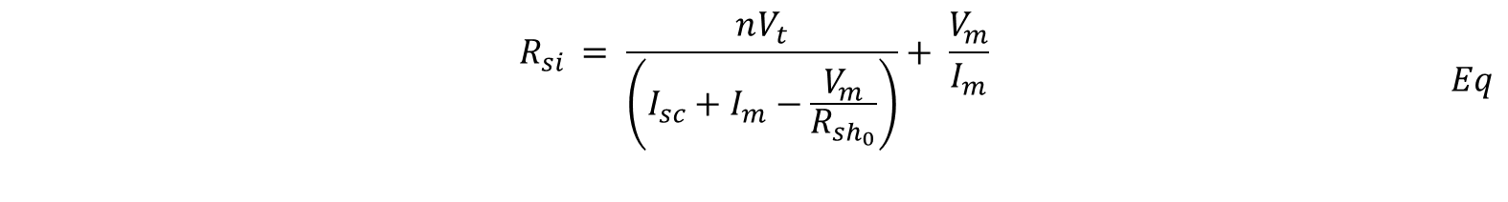
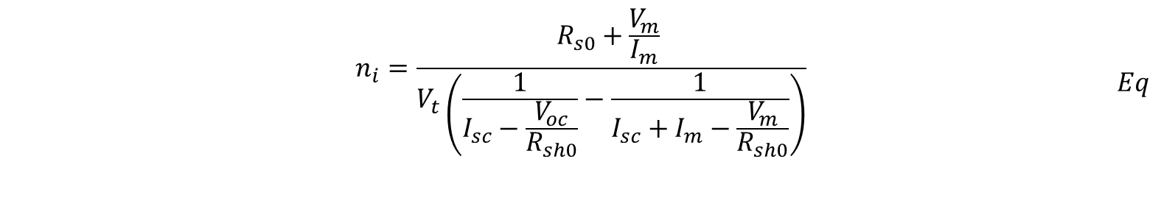
Equation 6 and 5 can be subtracted to obtain $n$ to as function of known parameters.
$$\begin{aligned}\begin{aligned}&n_{i}=\frac{R_{s0}+\frac{V_{m}}{I_{m}} }{V_{t}\left(\frac{1}{I_{sc}−\frac{V_{oc}}{R_{sh0}}}−\frac{1}{I_{sc}+I_{m}−\frac{V_{m}}{R_{sh0}}}\right)}\#\end{aligned}\#Eq\end{aligned}$$
$Rs$ can be retrieved by substituting the calculated in $n$ into equation (5). Equation (5) has been rearranged below to make $Rs$ as the subject of the formula.
$$\begin{aligned}\begin{aligned}&R_{si }= \frac{nV_{t}}{\left(I_{sc}+I_{m}−\frac{V_{m}}{R_{sh_{0}}}\right)}+ \frac{V_{m}}{I_{m}}\#\#\end{aligned}\#Eq\end{aligned}$$
$$\begin{aligned}&R_{shi }=R_{sh0}\#Eq\end{aligned}$$

Slide 22

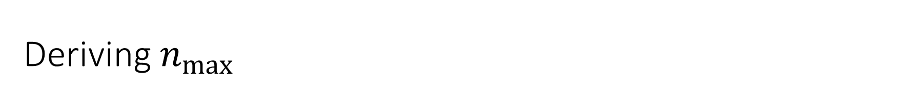

Deriving $n_{max}$
Recall
$$\begin{aligned}&R_{s0}= \frac{nV_{t}}{\left(I_{sc}−\frac{V_{oc}}{R_{sh_{0}}}\right)}+R_{s }\#\end{aligned}$$
Assume $Rs→ 0$and $Rsh→∞$
Is reduced to
$$n_{max}=\frac{R_{s0}I_{sc}}{V_{t}}$$

Slide 23
Results
Simulated IV characterization
Literature IV characterization
Perovskite sandwitch solar cells characterization

Slide 24
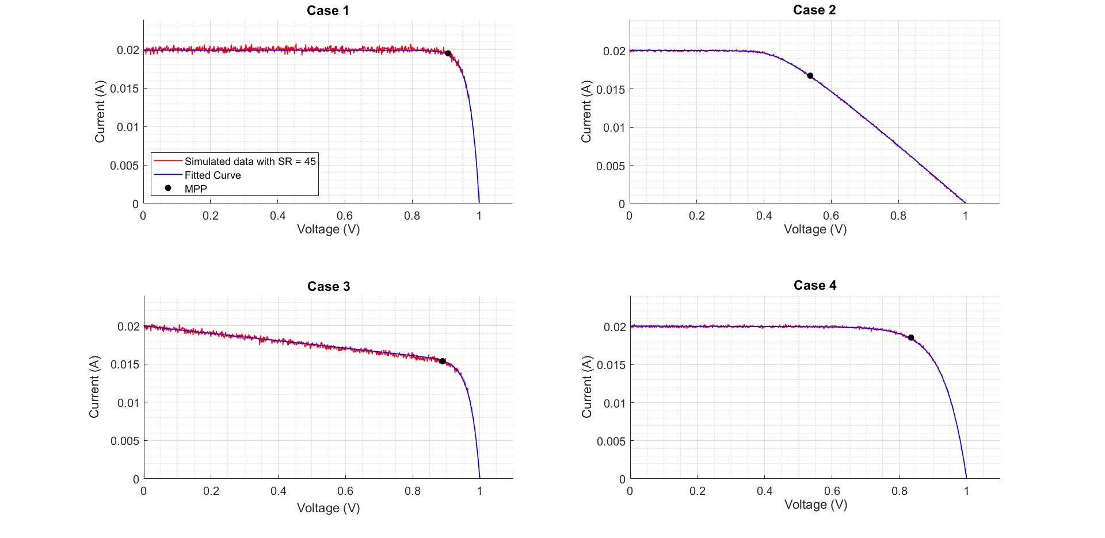
Simulated case 1 - 4

Slide 25
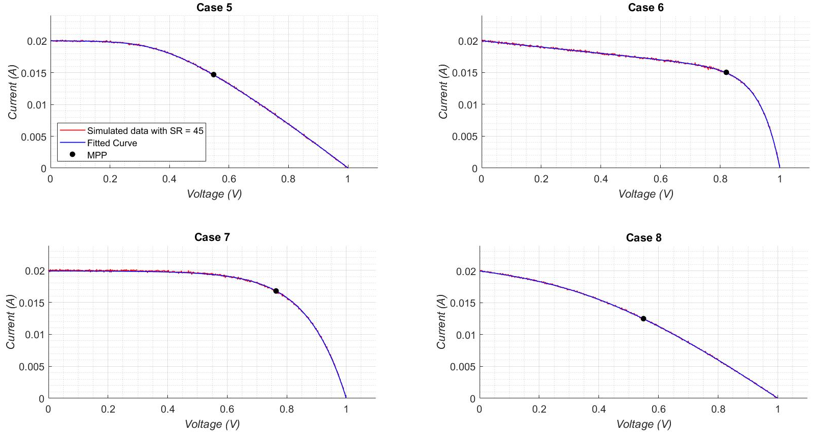
Simulated case 5 - 8

Slide 26
Simulated results
Case | Rs |  |  | Rsh |  |  | n |  |  | RMSE
 | Actual | Extract | %Error | Actual | Extract | %Error | Actual | Extract | %Error
1 | 0.10 | 0.07 | 33.08 | 1.00E+06 | 4.18E+04 | 95.82 | 1.00 | 1.00 | 0.00 | 1.32E-04
2 | 25.00 | 25.05 | 0.21 | 1.00E+06 | 4.22E+03 | 99.58 | 1.00 | 1.00 | 0.00 | 4.41E-05
3 | 0.10 | 0.00 | 99.90 | 2.00E+02 | 2.08E+02 | 3.85 | 1.00 | 1.06 | 5.53 | 1.12E-04
4 | 0.10 | 0.14 | 40.15 | 1.00E+06 | 6.63E+03 | 99.34 | 2.50 | 2.45 | 1.80 | 5.23E-05
5 | 25.00 | 25.22 | 0.86 | 1.00E+06 | 4.58E+03 | 99.54 | 2.50 | 2.42 | 3.09 | 3.20E-05
6 | 0.10 | 0.02 | 79.86 | 2.00E+02 | 2.02E+02 | 0.78 | 2.50 | 2.53 | 1.24 | 4.11E-05
7 | 0.10 | 0.53 | 426.42 | 1.00E+06 | 3.11E+04 | 96.89 | 5.00 | 4.72 | 5.55 | 7.62E-05
8 | 25.00 | 25.02 | 0.06 | 2.00E+02 | 2.09E+02 | 4.70 | 5.00 | 5.00 | 0.01 | 2.79E-05
Case 1 has highest RMSE in all cases
More noisy data
Large %error for high Rsh and low Rs
Low %error for n
RMSE is not ultimate indicator of accuracy
Observe case 3 and 1

Slide 27
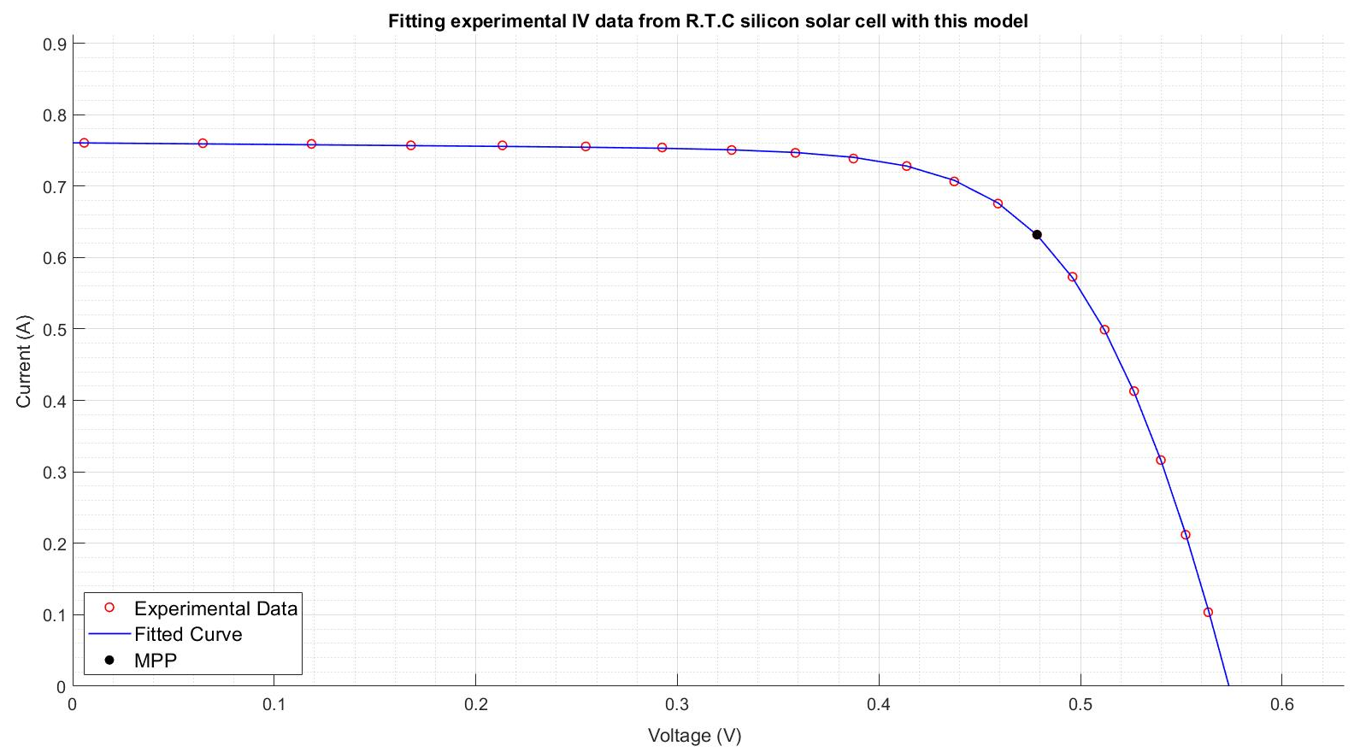
Fitting silicon solar cell IV data
Experimental data from a 57 mm diameter commercial (R.T.C France) silicon solar cell at 33 C.
Notes:
Explain the machine learning. Is sensitive and it doesn’t have physical meaning and based on

Slide 28
Comparing Bee Swarm Method with this model
Rs |  |  | Rsh |  |  | n |  |  | RMSE = ……
This method | Modified bee swarm | %Error | This method | Modified bee swarm | %Error | This method | Modified bee swarm | %Error | This method | Modified bee swarm | %difference
0.043 | 0.036 | 17.34 | 43.71 | 53.40 | 18.15 | 1.43 | 1.48 | 3.48 | 2.50E-03 | 9.86E-04 | 86.85
Notes:
Define RSME

Slide 29
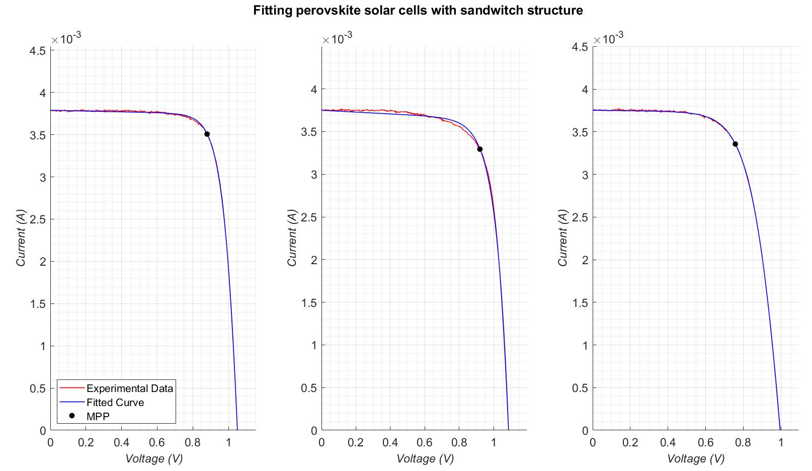
Fitting perovskite solar cells
Notes:
Make it clear that it is real data. The middle one doesn’t fit well due to abnomaility in the solar cells. Could be hysteresis.

Slide 30
Data | Rs | Rsh | n | RMSE
1 | 5.73 | 2.13E+04 | 2.10 | 1.07E-05
2 | 0.00 | 9.40E+03 | 2.76 | 2.88E-05
3 | 15.89 | 3.66E+04 | 3.11 | 6.50E-06
Notes:
Keep the scale the same. Don’t keep it as zero.

Slide 31
Conclusion

Slide 32
Limitations and future work
Cells with extremely large Rsh or low Rs cannot be extracted accurately
In some cases the single diode may not be an accurate representation of the IV data.
Notes:
Conclusion. Highlight what we achived. And we need do say everything we did. Just make it understand we.

Slide 33
Acknowledgments
Professor Udo Bach
Dr Kevin Rietwyk
Dr Sonia Ruiz Raga
Mr Adam Surmiak
Ms Boer Tan

